Slide 1
Loan Default
Exploratory Data Analysis
By
Suresh Kumar Muvvala
(suresh.kumar0465@gmail.com)

Slide 2
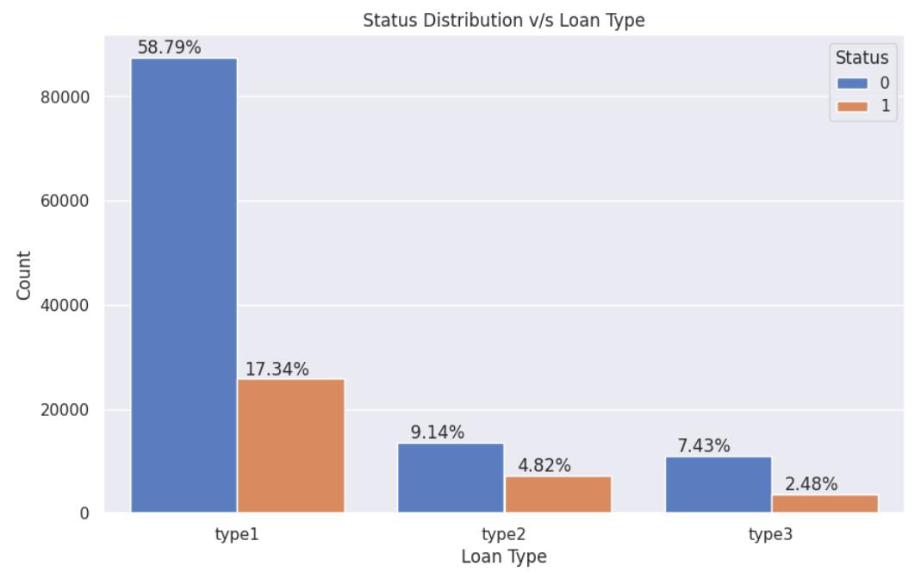
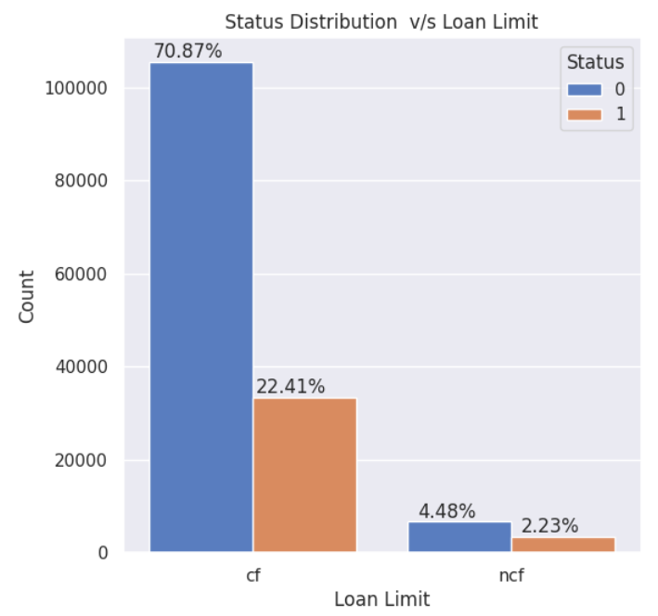
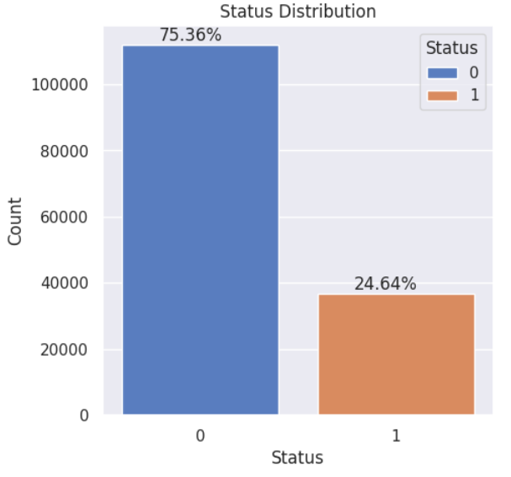
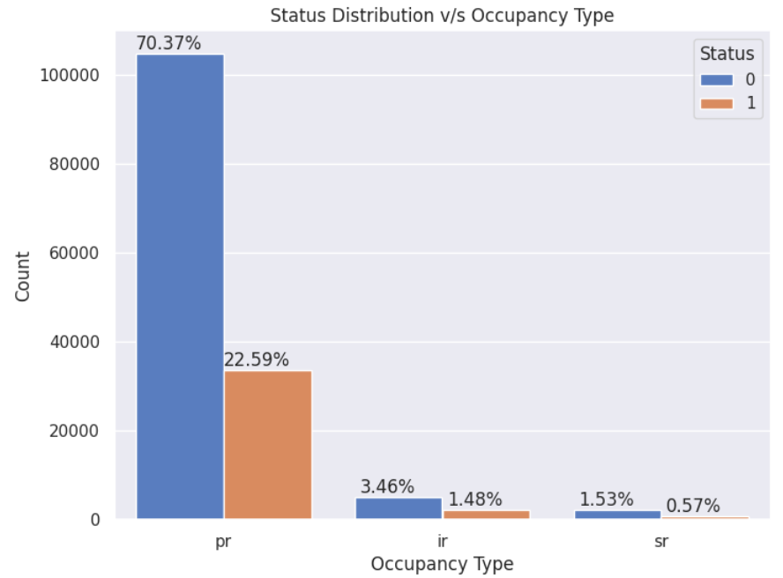
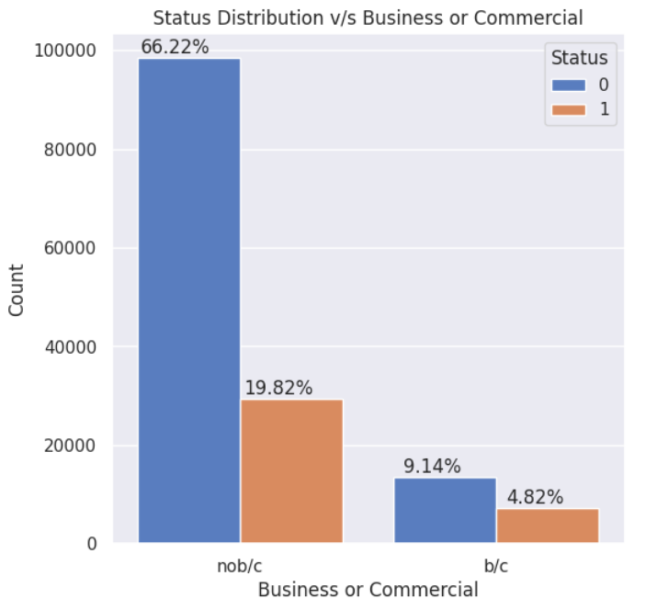
Problem Statement - Defaulter characteristics Identification
For any banking and financial services identifying the customer’s ability to repay the loan without default is very crucial for the firm to maintain its Financial Stability.
From the given dataset identify the customer characteristics which help to identify the defaulter’s behavior and hence firms can take extra precautions while lending to the customers.
93%
76%
1 in 4
93%
86%
DATA DISTRIBUTION

Slide 3
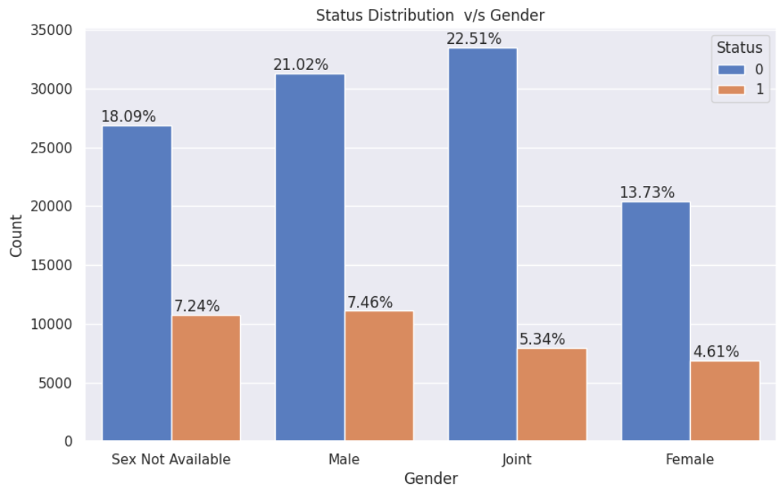
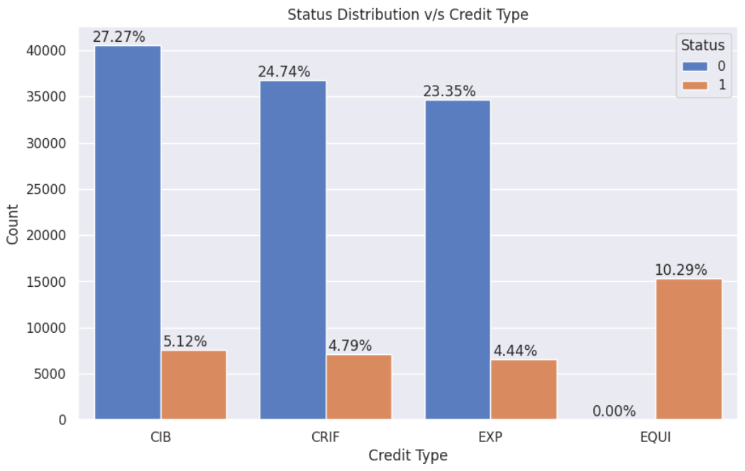
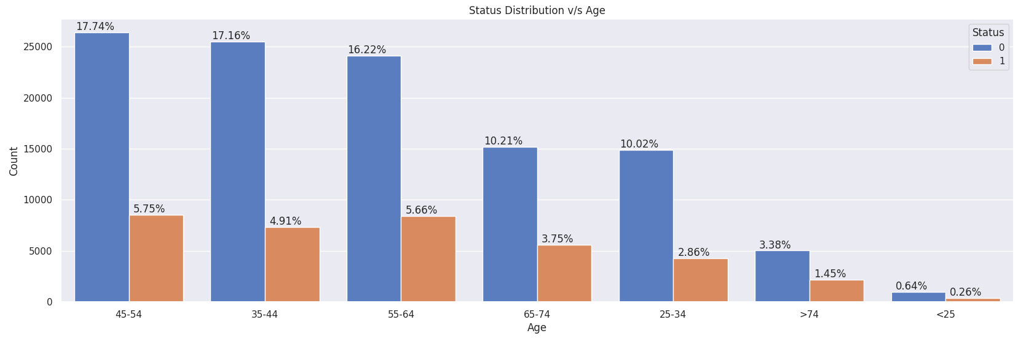
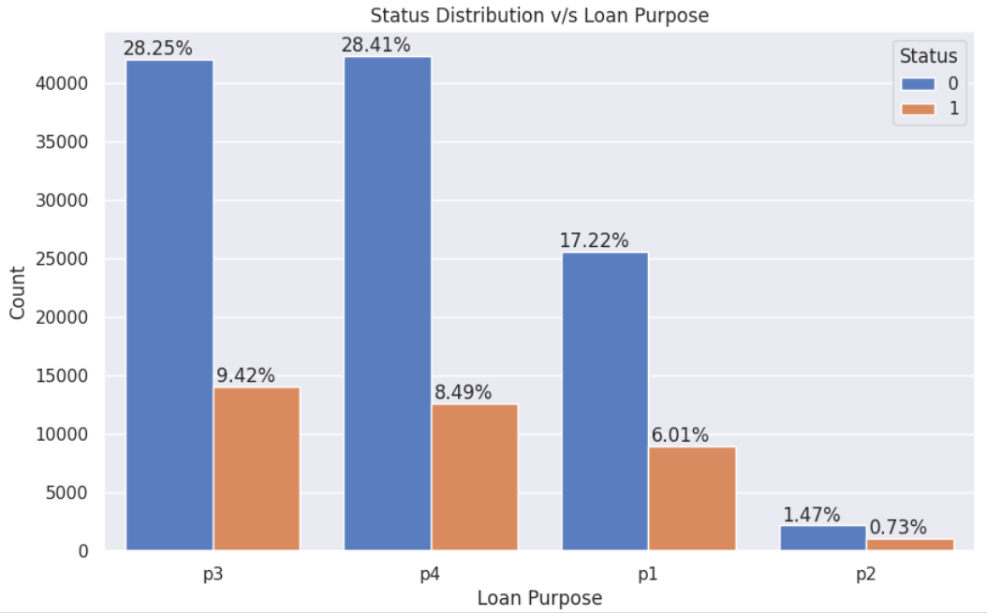
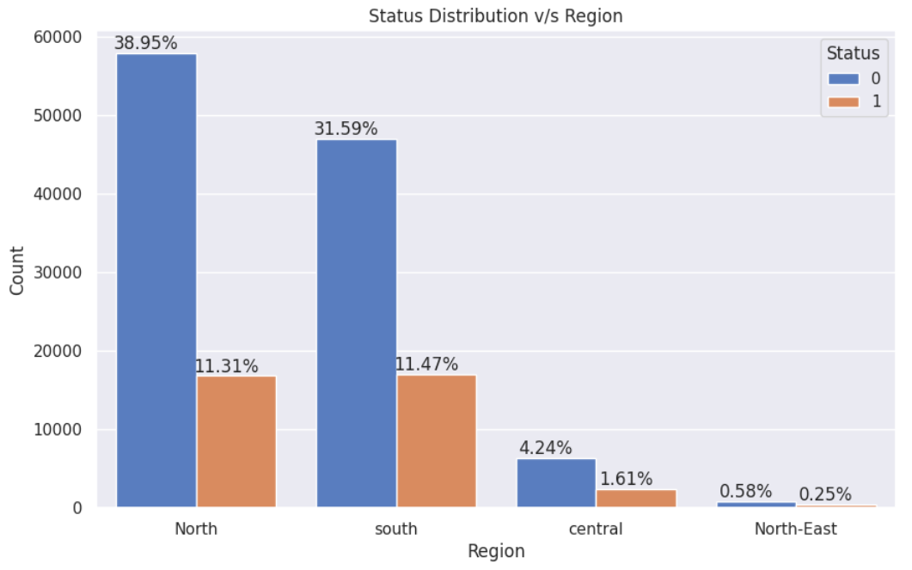
Data Distribution - Contd...
28%
18%
32%
28%
28%
22%
22%
22%
13%
13%
5%
1%
37%
50%
43%

Slide 4
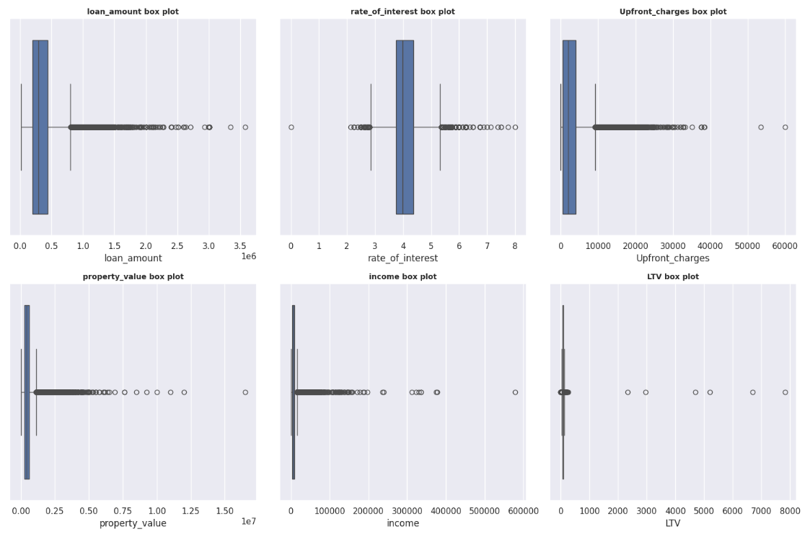
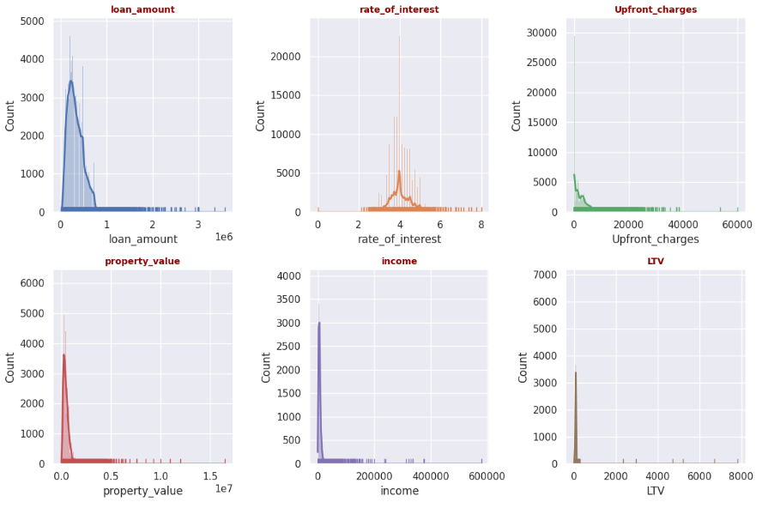
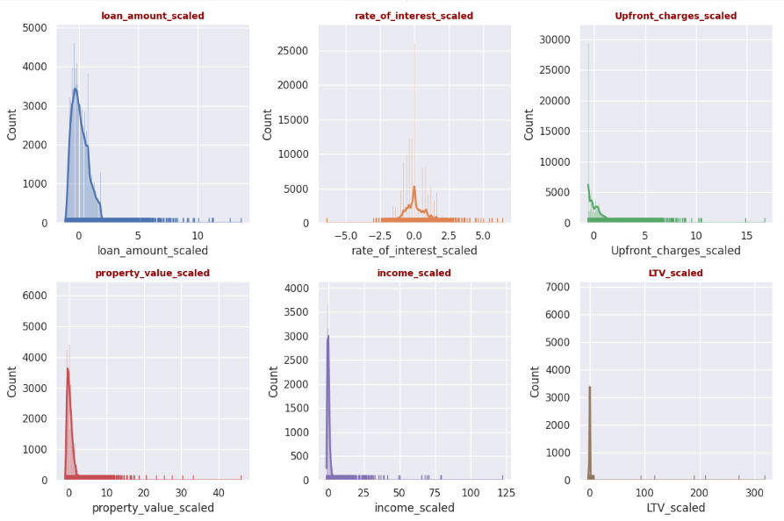
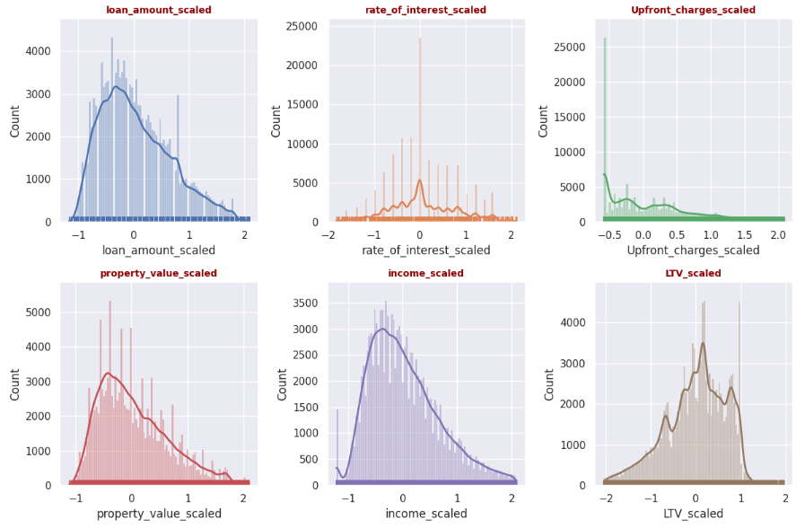
Outliers Analysis - Box Plot , Histogram Plot, Robust Scaler
After removing Outliers
Loan Amount: Right-skewed, suggests that lower loan amounts are more common than higher ones.
Property Value: Right-skewed, indicate that most property values are on the lower end.
Rate of Interest: This plot is quite peaked, suggests that most interest rates are clustered around a central value, indicating less variability.
Income: Right-skewed, implying that there are more instances of lower incomes compared to higher incomes.
Upfront Charges: Distribution is relatively uniform but slightly right-skewed.
LTV Ratio: Somewhat bell-shaped but leans towards being left-skewed, indicating that higher LTV values are less common.

Slide 5
Numerical Data Distribution, Skewness, Kurtosis w/o outliers
* loan_amount_scaled: p-value = 4.3470779416275215e-93 => No Normal Distribution
* rate_of_interest_scaled: p-value = 7.629171974175543e-70 => No Normal Distribution
* Upfront_charges_scaled: p-value = 6.196234576781424e-117 => No Normal Distribution
* property_value_scaled: p-value = 4.353560534605727e-99 => No Normal Distribution
* income_scaled: p-value = 4.389027706995818e-93 => No Normal Distribution
* LTV_scaled: p-value = 1.9985699346514394e-83 => No Normal Distribution
Loan Amount:
Skewness (0.639602): Positively skewed, indicating a longer tail on the right side of the distribution.
Kurtosis (-0.194966): Slightly platykurtic, suggesting a flatter distribution than a normal distribution.
Rate of Interest:
Skewness (0.169248): Slightly positively skewed, indicating a minor right tail.
Kurtosis (-0.203145): Slightly platykurtic, indicating a flatter distribution.
Upfront Charges:
Skewness (0.861933): Positively skewed, indicating a longer right tail.
Kurtosis (-0.029300): Nearly mesokurtic, close to a normal distribution.
Property Value:
Skewness (0.766133): Positively skewed, indicating a longer right tail.
Kurtosis (0.046964): Nearly mesokurtic, close to a normal distribution.
Income:
Skewness (0.724931): Positively skewed, indicating a longer right tail.
Kurtosis (0.166788): Nearly mesokurtic, close to a normal distribution.
LTV:
Skewness (-0.539304): Negatively skewed, indicating a longer tail on the left side of the distribution.
Kurtosis (-0.125382): Slightly platykurtic, indicating a flatter distribution.
Most variables are positively skewed, meaning they have longer tails on the right side only LTV ratio is the exception.
Most variables have kurtosis values are close to normal, with slight deviations indicating either flatter or slightly peaked distributions.

Slide 6
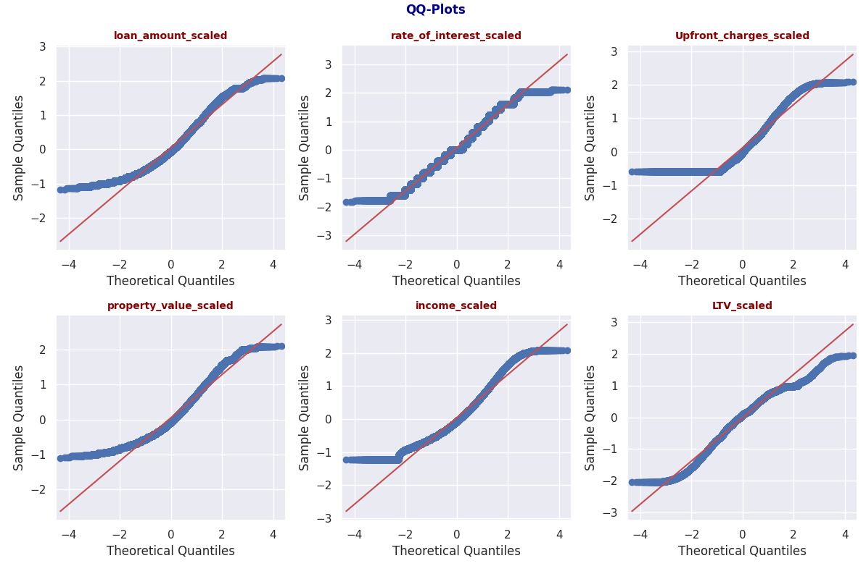
Numerical Data QQ Plots
Loan Amount :
The blue dots deviate from the red line, especially at the tails, indicating that the distribution has heavier tails than a normal distribution.
Rate of Interest:
The blue dots are fairly close to the red line, suggesting that the distribution is approximately normal.
Upfront Charges:
The blue dots show some deviation from the red line, particularly in the tails, indicating a distribution with heavier tails than normal.
Property Value:
The blue dots deviate from the red line, especially at the tails, suggesting a distribution with heavier tails than a normal distribution.
Income:
The blue dots are close to the red line, indicating that the distribution is approximately normal.
LTV:
The blue dots deviate from the red line, particularly in the tails, indicating a distribution with heavier tails than normal.
Most of the variables show some deviation from normality, particularly in the tails, suggesting that they have heavier tails than a normal distribution.
The rate of interest and income scaled variables are closer to normal distributions compared to the others.

Slide 7
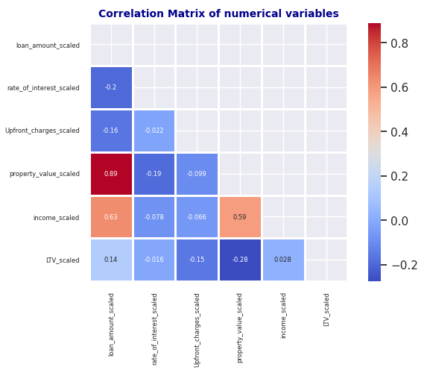
Numerical Data Correlation w/o outliers
Heat map provides a visual summary of how different financial variables relate to one another, which can be useful for identifying patterns or areas for further investigation.
Strong Positive Correlation:
Property Value and Loan Amount (0.89): This indicates that as the property value increases, the loan amount tends to increase as well.
Moderate Positive Correlation:
Income and Loan Amount (0.63): Higher income is associated with larger loan amounts, suggesting that individuals with higher incomes tend to take out larger loans.
Weak or No Correlation:
Rate of Interest and Income (-0.078): There is a very weak negative correlation, indicating almost no relationship between the rate of interest and income.
LTV and Income (0.14): This shows a weak positive correlation, suggesting a slight tendency for higher income to be associated with higher LTV ratios.
Negative Correlation:
LTV and Property Value (-0.28): This indicates a mild negative correlation, suggesting that higher property values might be associated with lower LTV ratios.

Slide 8
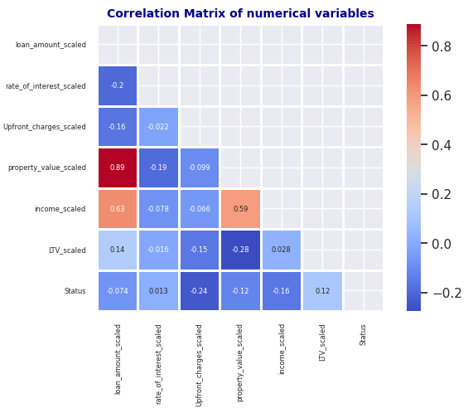
Numerical Data Correlation w.r.t Loan Status w/o outliers
Weak Positive Correlation:
Upfront Charges (Correlation: 0.24): This indicates that higher upfront charges might be slightly associated with Default
Income (Correlation: 0.16): This indicates that higher income might be slightly associated with Default
LTV (Correlation: 0.12): This indicates that higher LTV might be slightly associated with Default
Weak Negative Correlation:
Property Value (Correlation: -0.12): This indicates that higher property values might be slightly associated with a normal status, though the relationship is not strong.
Very weak or No Correlation:
Loan Amount (Correlation: -0.074): There is a very weak negative correlation between loan amount and status. This suggests that the loan amount has little to no impact on the status.
Rate of Interest (Correlation: 0.013): The correlation is almost zero, indicating no significant relationship between the rate of interest and status.

Slide 9
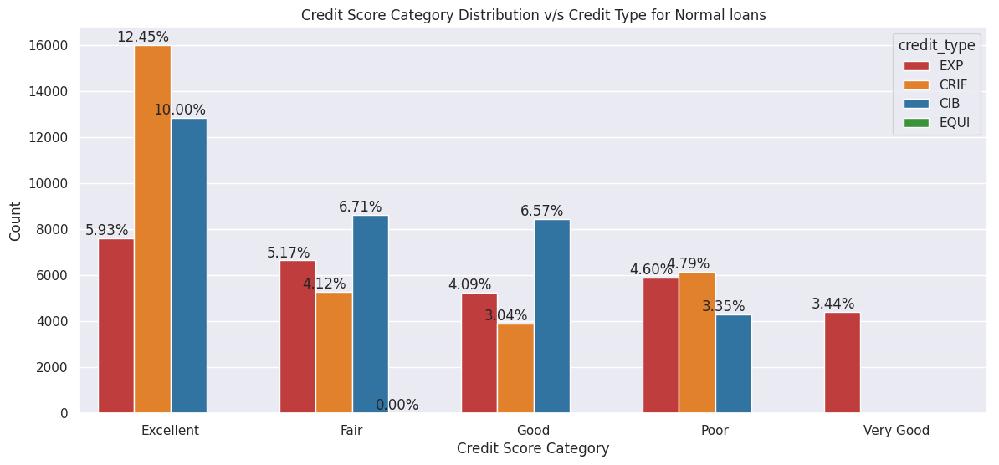
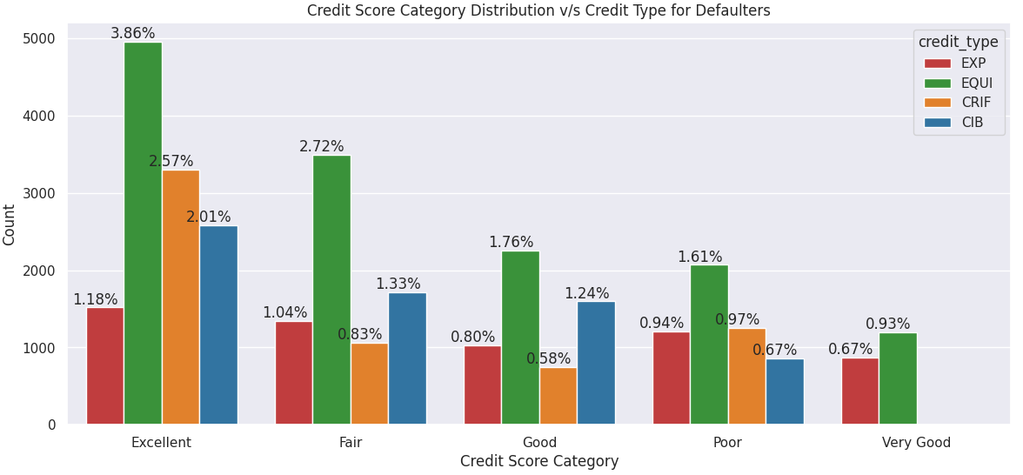
Credit Score and Credit Type Normal v/s Default w/o outliers
Equifax customers has highest defaulters in each category.
All loans reported from Equifax belongs to defaulters only.
CIBIL and CRIF has no Very Good Category compared with other.
CIBIL, CRIF, EXPERIAN has 28-32% of contribution
EQUIFAX has only 10% contribution which is again only default loan information
The distribution is more balanced across all credit types excluding EQUIFAX..

Slide 10
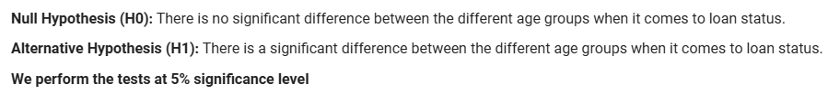
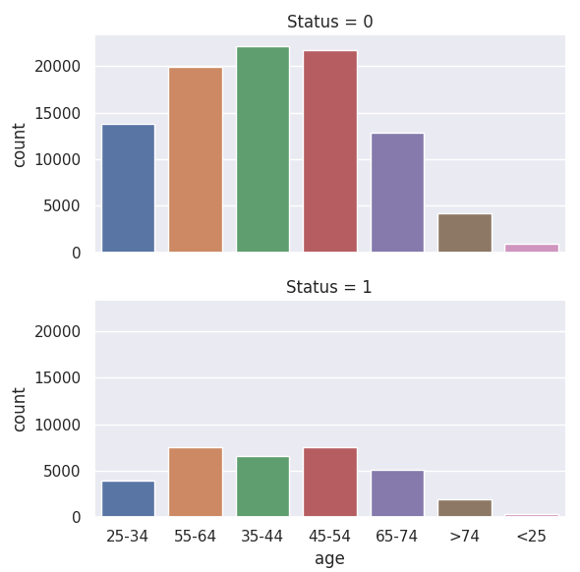
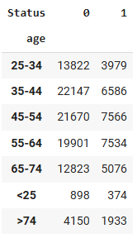
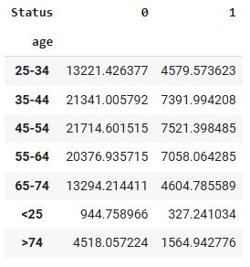
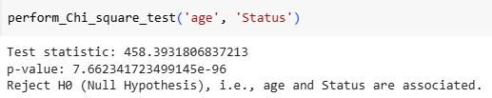
Hypothesis Testing - Different Age Groups v/s Loan Status
Observed v/s Expected Values

Slide 11
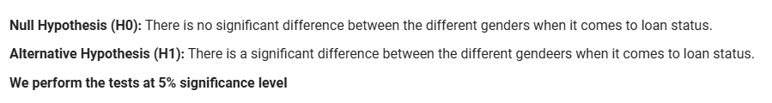
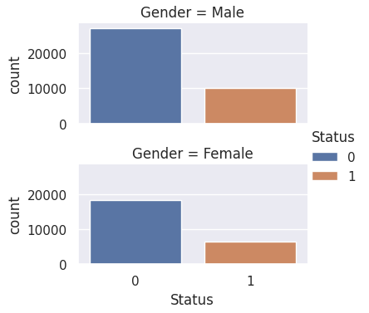
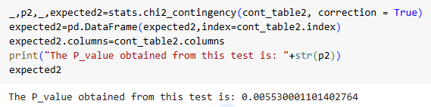
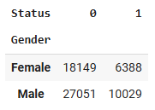
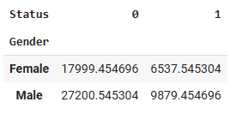
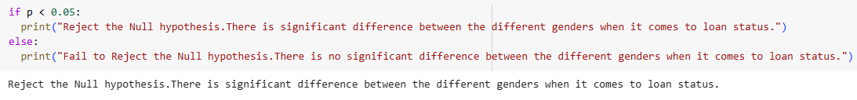
Hypothesis Testing - Gender (Male & Female) v/s Loan Status
Observed v/s Expected Values

Slide 12
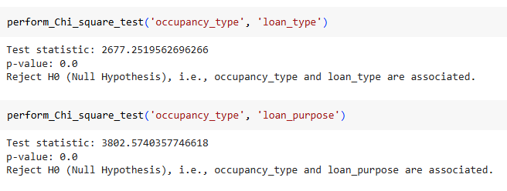
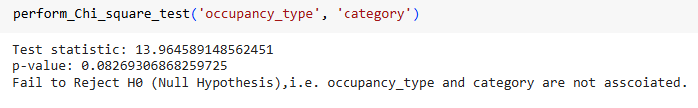
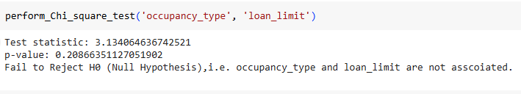
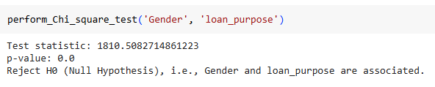
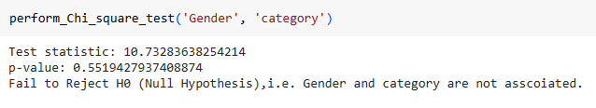
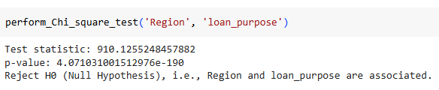
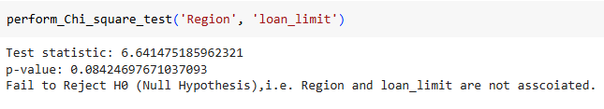
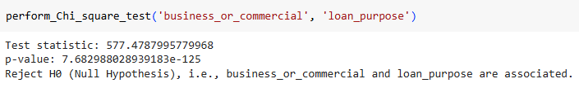
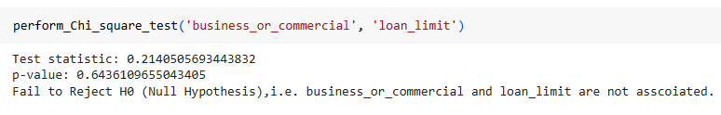
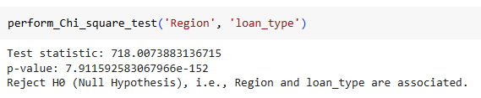
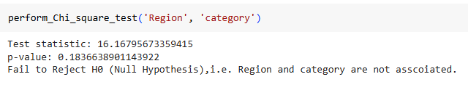
Hypothesis Testing - Association b/w different features

Slide 13
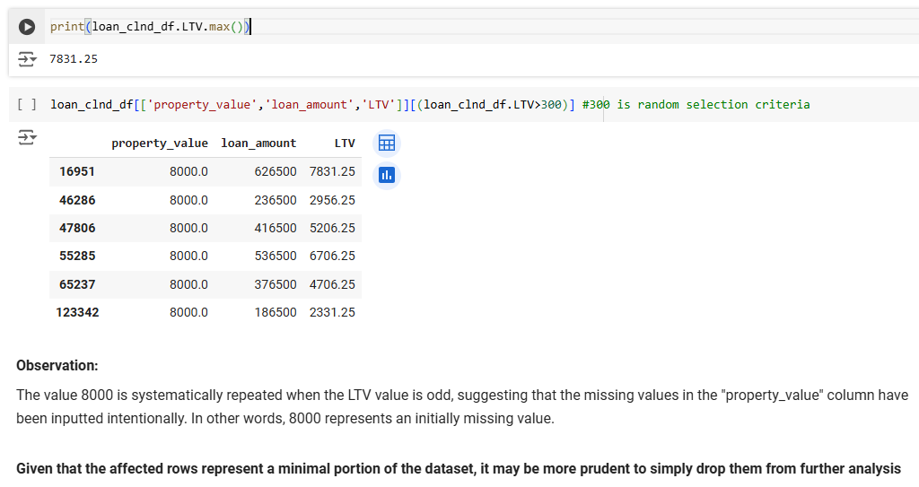
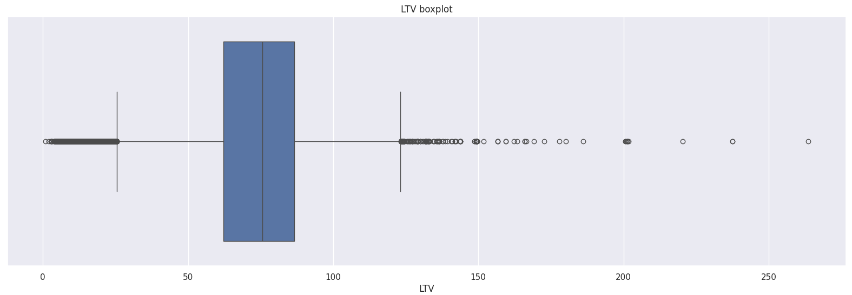
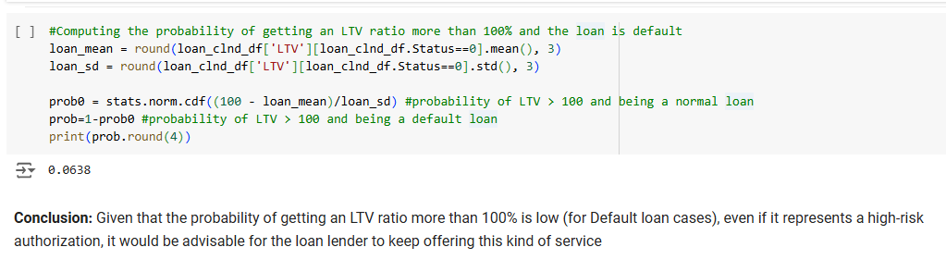
Probability - Life-Time Value (LTV) ratio greater than 100% for loans that are default?

Slide 14
Recommendations
1 out of 4 loans is defaulter i.e., 25% chance of loan become a default suggests to improve the risk management strategies.
Given a loan is default, 42% probability being the customer data reported by Equifax.
With strong positive correlation (0.89) suggests that higher property values are associated with larger loan amounts. This can help in changing risk assessment models from conservative to moderate and loan approval processes.
With moderate positive correlation (0.63) suggests that individuals with higher incomes tend to take out larger loans. This can be useful for targeting high-income customers with premium loan products and extra benefits like top-up loans.
A mild negative correlation (-0.28) indicates that higher property values might be associated with lower LTV ratios. This can help in assessing the risk of loans; properties with higher values might be less risky.
Loan Portfolio -
Deeply penetrated only in North and South with 93% but Central and North East regions are only 7% - Look for expansion opportunities either through opening new branches or acquiring the existing business through partnerships or mergers.
Concentrated only on type 1 loans with 76% share. Evaluate what are challenges associated with type 2 or type 3 loans, identify the customer group and devise the marketing strategies to educate customers about the benefits of these loans.
Only 2% of loans are given to the P2 Loan purpose.
Only 5% of loans are given to the people with age < 25 and > 74. Target the customers in this age groups with either higher income or higher property value.
Probability of default is very low with 0.06% even if the customer gets > 100% loan value compared to his property. Recommend to leverage this strategy with targeted customer base as a pilot.

